Slide 2
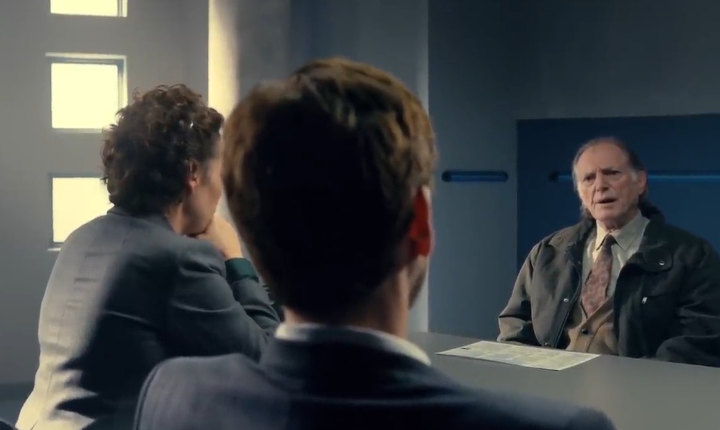
Imagine that you are a friend of the victim
100%
50%
0%
50%
100%
Guilty
Innocent
0% Certain

Slide 3
Imagine that you are a friend of the victim
100%
50%
0%
50%
100%
Guilty
Innocent
25% Certain

Slide 4
Imagine that you are a friend of the victim
100%
50%
0%
50%
100%
Guilty
Innocent
65% Certain

